Slide 1
INF10004 ‘Database Analysis and Design’{
INTRODUCTION.sql
workshop.sql
[Oral Presentation]
How to write select statement?
--103488515 HAI NAM NGO
}
Contents from Week 1, Week 2 and Week 4

Slide 2
Table Of ‘Contents’
01
02
INTRODUCTION.sql
workshop.sql
ERD RELATIONSHIP
Borrowed Identifiers (Week 4)
Strong and weak entities (Week 4)
Atributes (Week 1)
Cardinality of relationship (Week 1)
SELECT Statement
Basic commands, Inner joins, Aggregate Functions (W1,W2,W4)
Prevalent errors
Coding and debugging (Week 1)
SQL: Column ambiguously defined (Week 2)
Not a single-group group function (Week 4)
03
Practical Exercise
Requirement 8,14,19: Select Statement
Contents from Week 1, Week 2 and Week 4

Slide 3
01 {
ERD RELATIONSHIP
INTRODUCTION.sql
workshop.sql
Borrowed Identifiers
Strong and weak entities
Atributes
Cardinality of relationship
}
Contents from Week 1, Week 2 and Week 4

Slide 4
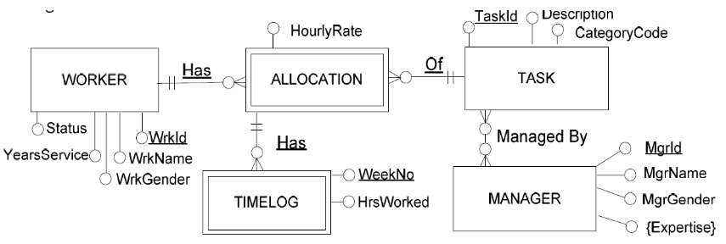
ERD RELATIONSHIP {
INTRODUCTION.sql
workshop.sql
Atributes
Atributes are objects that are contained in the table
When execute in SQL Junior, they will be displayed as column names
}
Contents from Week 1, Week 2 and Week 4

Slide 5
ERD RELATIONSHIP {
INTRODUCTION.sql
workshop.sql
Borrow Identifiers
If the relationship is a part of the identifier
-> relationship name will be underlined
}
Contents from Week 1, Week 2 and Week 4

Slide 6
ERD RELATIONSHIP {
INTRODUCTION.sql
workshop.sql
Weak entities
A weak entity is an entity type that borrows part, or all of its identifier
}
Contents from Week 1, Week 2 and Week 4

Slide 7
ERD RELATIONSHIP {
INTRODUCTION.sql
workshop.sql
Cardinality of relationship
One-to-One: none
One-to-Many: three
Many-to-Many: one (must create junction table)
}
Contents from Week 1, Week 2 and Week 4

Slide 8
02 {
SELECT Statement
INTRODUCTION.sql
workshop.sql
Basic commands
Inner joins
Aggregate Functions (COUNT,SUM,AVG)
Prevalent errors
}
Contents from Week 1, Week 2 and Week 4

Slide 9
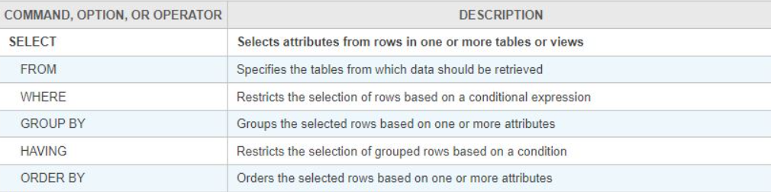
SELECT Statement {
INTRODUCTION.sql
workshop.sql
Commands
SELECT [column name1],[column name2]
FROM [table name]
WHERE [criteria]
GROUP BY [column name1],[column name2]
ORDER BY [column name] asc(desc);
}
Contents from Week 1, Week 2 and Week 4

Slide 10
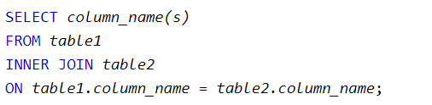
SELECT Statement {
INTRODUCTION.sql
workshop.sql
INNER JOIN keyword selects records that have matching values in both tables.
}
Contents from Week 1, Week 2 and Week 4

Slide 11
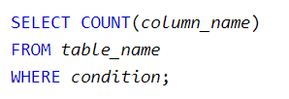


SELECT Statement {
INTRODUCTION.sql
workshop.sql
Aggregate function
returns the total sum of a numeric column.
returns the average value of a numeric column.
returns the number of rows that matches a specified criterion.
}
Contents from Week 1, Week 2 and Week 4

Slide 12
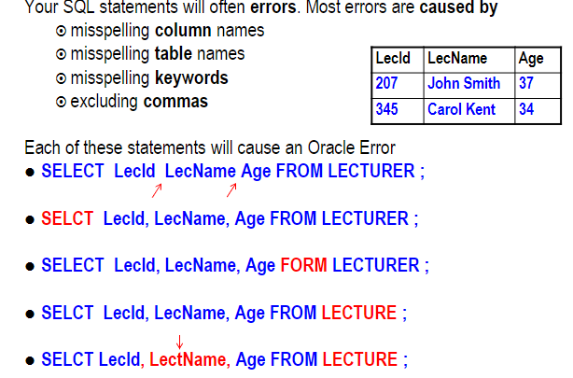
Prevalent Errors {
INTRODUCTION.sql
workshop.sql
Coding and debugging (wrong spelling)
}
Contents from Week 1, Week 2 and Week 4

Slide 13
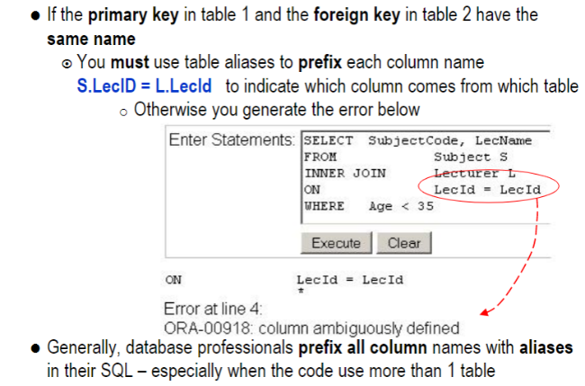
Prevalent Errors {
INTRODUCTION.sql
workshop.sql
SQL: Column ambiguously defined
}
Contents from Week 1, Week 2 and Week 4

Slide 14
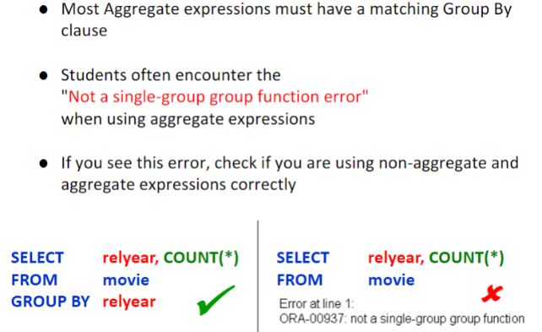
Prevalent Errors {
INTRODUCTION.sql
workshop.sql
Not a single-group group function
}
Contents from Week 1, Week 2 and Week 4

Slide 15
03 {
Practical Exercise
INTRODUCTION.sql
workshop.sql
Requirement 8.1 8.2 8.3 8.4 (use count)
Requirement 14.5 (use sum,inner join)
Requirement 19.3 (use avg, where clause)
Reason why I choose these requirement:
They can cover all the contents that I just
mentioned above, mostly SELECT statement
(no time to go through all of them)
}
Contents from Week 1, Week 2 and Week 4

Slide 16
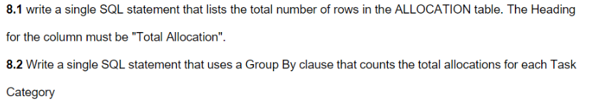
REQUIREMENT 8
DO THE ASSIGNMENT.sql
Contents from Week 1, Week 2 and Week 4

Slide 17
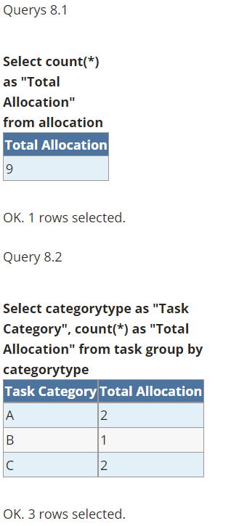
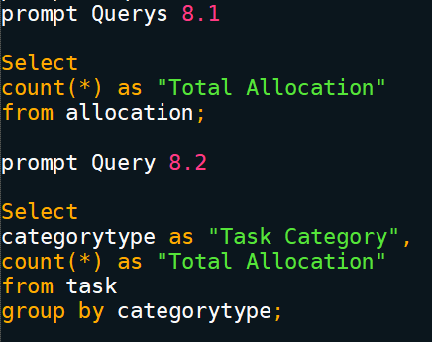
Requirement 8
INPUT
OUTPUT
Contents from Week 1, Week 2 and Week 4

Slide 18
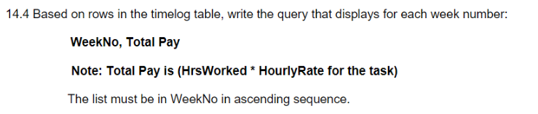
REQUIREMENT 14.4
DO THE ASSIGNMENT.sql
Important information from the task:
List the WeekNo, Total Pay (HrsWorked * Hourlyrate) (use SUM function)
From timelog table
But the HourlyRate is from allocation table (use inner join)
WeekNo asc
Contents from Week 1, Week 2 and Week 4

Slide 19
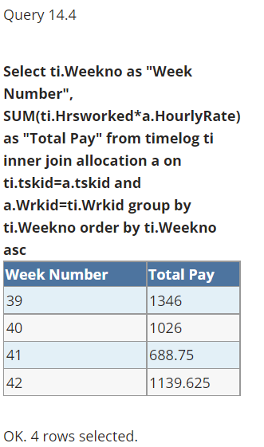
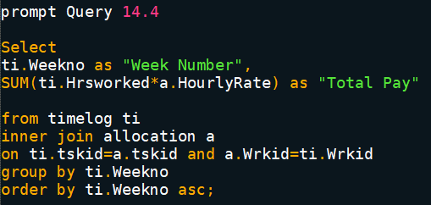
Requirement 14.4
INPUT
OUTPUT
Contents from Week 1, Week 2 and Week 4

Slide 20
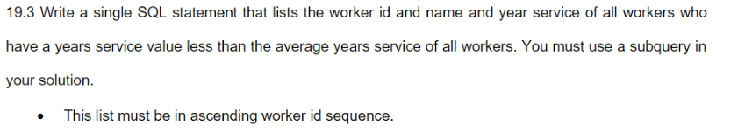
REQUIREMENT 19.3
DO THE ASSIGNMENT.sql
Important information from the task:
List the worker id, name,year service
Only workers who have a years service value < AVG
Must use subquery
Worker id asc
Contents from Week 1, Week 2 and Week 4

Slide 21
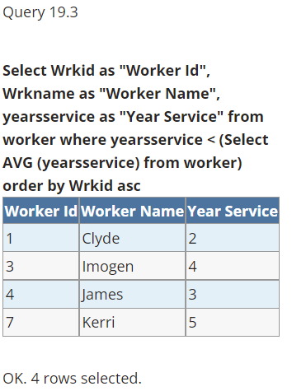
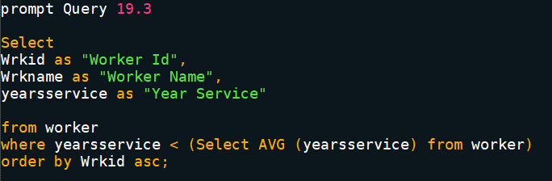
Requirement 19.3
INPUT
OUTPUT
Contents from Week 1, Week 2 and Week 4

Slide 22
References {
INTRODUCTION.sql
workshop.sql
SQL COUNT(), AVG() and SUM() Functions 2019, W3schools.com.
Wijesinghe, R n.d., Week 1 Lecture, 2022-SC3-INF10004-Database Analysis and Design-H1.
Wijesinghe, R n.d., Week 2 Lecture, 2022-SC3-INF10004-Database Analysis and Design-H1.
Wijesinghe, R n.d., Week 4 Lecture, 2022-SC3-INF10004-Database Analysis and Design-H1.
(All the input and output comes from my group assignment)
}
Thank you for spending your time to watch my video^^
Contents from Week 1, Week 2 and Week 4

